Slide 1
Deep Dive into JavaScript
=> Mohan

Slide 2
Session Curriculum
Syntax parsers ~ Microprocessors
Low level and High level languages
Memory management ~ Garbage collectors
Call By Reference Hooks and Why Arrays are Objects
JavaScript compiler Engine & Scope :
Execution Contexts,Lexical Environments,Call stack,Heaps,Closures
Event loop & Hosting environments
Debunking WTF JS with Coercion

Slide 3
Microprocessors
INSTRUCTIONS
IA-32
ARM
X86-64
MIPS
Microprocessor

Slide 4

Syntax Parsers
function foo(){
var a=5;
}
X64 or x32 Instructions
Takes your code and turn it into your processor’s instructions

Slide 5
Lets see some Machine code ?
You don’t have to but Here goes

Slide 6
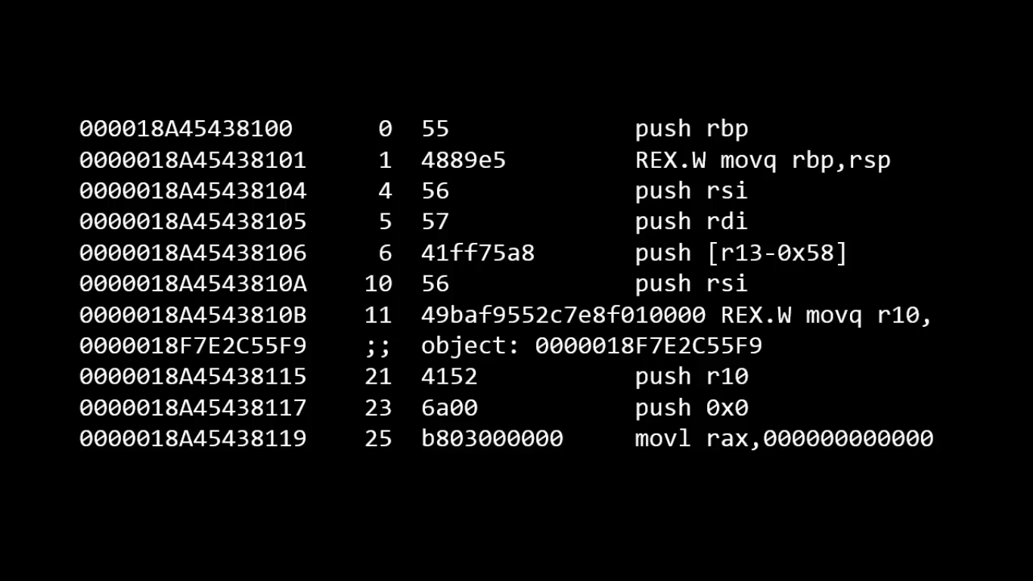

Slide 7
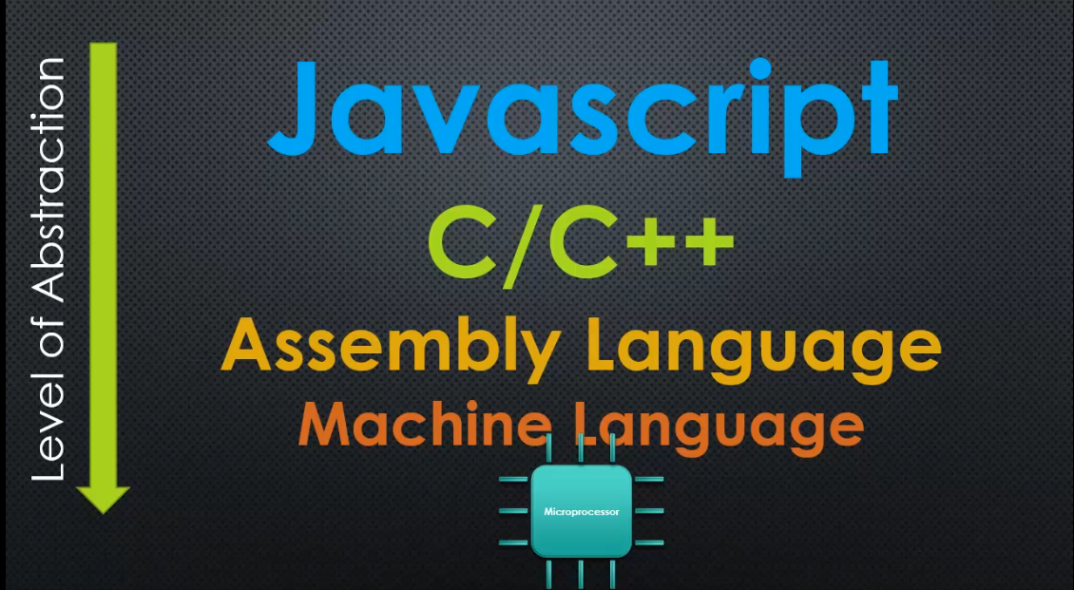

Slide 8
Abstraction ?
Lets see an example

Slide 9
Memory Management
Memory life cycle is pretty much always the same in all languages:
Allocate the memory you need
Use the allocated memory (read, write)
Release the allocated memory
Malloc() in low-level languages
Free() in low-level languages

Slide 10
In Low-Level languages like C or C++ Memory management is explicit
When the amount of memory is not needed anymore, you must return it to the operating system by calling the function free.
So really tedious to work around Memory management in low-level
Languages

Slide 11
a=“hello” //string stored in Memory and a points to the value
a=“ram” //Now a points to String “ram”
But the String “Hello” will still be in memory
free(a) //Which tells to free the memory which (a) pointed to
Now “hello” is removed from the memory
a=“ram”
But we never do those stuff / can’t In JS rite Our garbage collector takes care of all of those stuff
We just write
var a=“hello”;
a=“foo”

Slide 12
Garbage collectors
A special piece of program in the JavaScript engine that frees unused memory and reallocates it to something else when its required
It frees the allocated memory when the reference counter is 0
Example:
a=“hello” // The string ‘hello’ has 1 reference now
b=a // The string ‘hello’ has 2 references now
a=“world” // ‘hello’ now has 1 references
b=a // 0 References to ‘hello’ Garbage collector takes it out

Slide 13
Explicit Memory Management
var data=[………..100 array items] from database 1mb of JSON data
Giving data=undefined or null makes Reference counter to hit 0
We are explicitly saying the garbage collector to collect and delete the 1mb of array data from memory

Slide 14
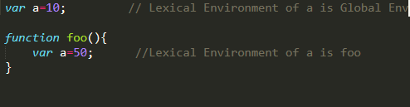
Lexical Environment
Where your code physically sits // On which Environment/Scope your
code sits

Slide 15
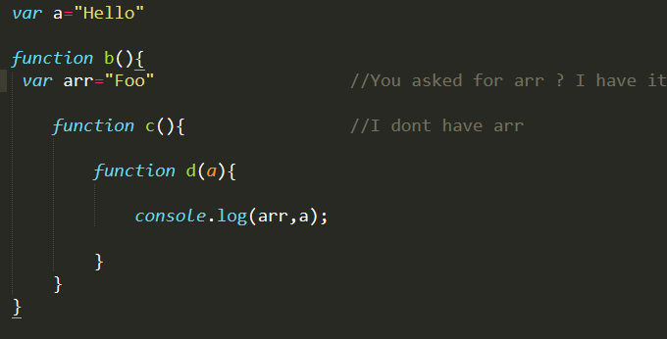
Lexical Scope
Where your code physically written/sits is where its scope is gonna be

Slide 16
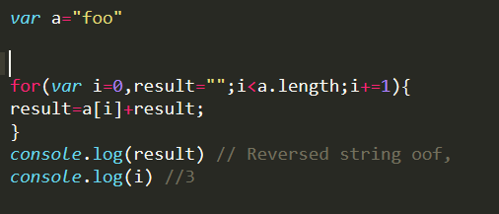
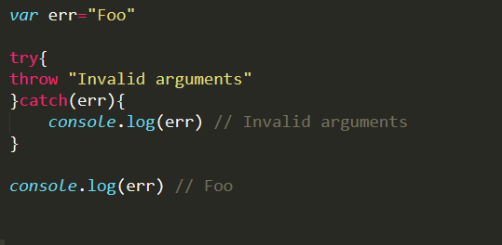
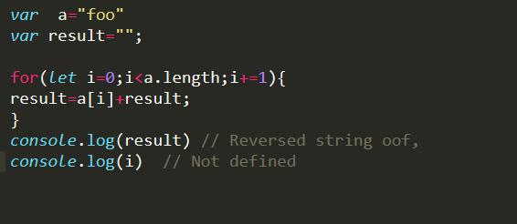
Do we have Block scope in this language?

Slide 17
Call by value and reference
var a=10;
A
var b=[1,2,3];
b
c=b
c=10
10
1011
[1,2,3]
10

Slide 18
The Big Bang of Execution
Global Execution Context
Execution stack or Call Stack
Heap

Slide 19
Heaps
A Permanent unordered storage place where everything you store is available till The program dies
Variable allocation happens here

Slide 20
Execution Context
Also known as stack frames / Activation records
It’s the Lexical environment your code is currently executing
It acts as a wrapper / Chunk of memory that helps to manage your code
Window Object
this
Outer environment
Variable Environment
Execution Context

Slide 21
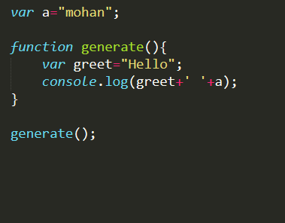
Execution stack
Console.log Execution Context
Window Object
this
Outer environment:global
Variable Environment
Generate execution context
Window Object
this
Outer environment
Engine
Compiler
Scope
Null
Variable environment
Global Execution Context or Base Execution context

Slide 22
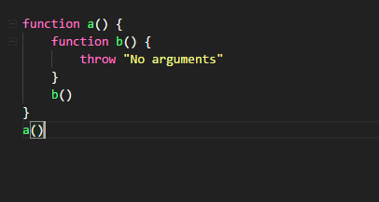

What if an error occurred in execution
Execution stack
b
a
Global

Slide 23
Hmmm?
a = 2;
var a;
console.log(a);

Slide 24
Another one
var b = [1, 2, 3, 4, 5];
var b;
tally(b);
function tally(input){
return input.reduce((acc,data)=>acc+data); // Gives the Total of the Array
}

Slide 25
Closures
Inner functions always remember their parent even if they are ripped out and executed somewhere else
Or
A function will always remember its lexical scope even if it is lexically executed outside

Slide 26
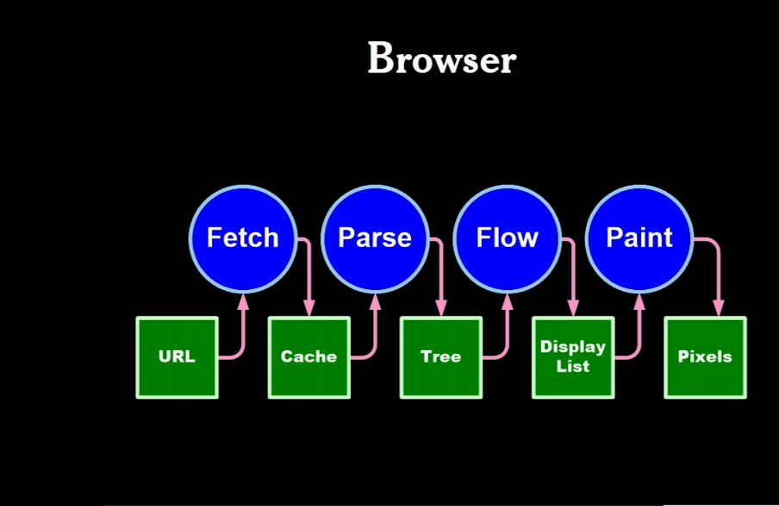
JavaScript
Engine
CSSOM
DOM

Slide 27
JavaScript is single threaded
It can do only one line at a time
It cant do multiple steps

Slide 28
Lets visualize the Event loop
Using Loupe

Slide 29
What is Blocking Code ?

Slide 30
username=getSync(‘http://some.github.io/map.json’);
emailList=getSync(‘http://some.github.io/map.json’);
passList=getSync(‘http://some.github.io/map.json’);
getSync
getSync
getSync
Global

Slide 31
Coercion
3+ true //Evaluates to false [True evaluates to 1]
‘Foo’+5 // Evaluates to ‘Foo5’ [5 gets coerced to String]
0==False //True [False gets coerced to 0]
0==‘ ’ //True [Empty strings gets coerced to 0]

Slide 32
Falsy values in JavaScript
+0 -0
Null
Undefined
Nan
“”
False
Everything else is true

Slide 33
Operator Overloading
Plus operator(+)
+’56’ => 56 //Gets Coerced to a number
5+5=10
‘foo’+5=‘foo5’ // Gets Coerced to a string
Minus,Multiply,Division operator (-)
If they get anything other than no’s as their operand They coerce them to their Number form

Slide 34
Implicit coercion in Logical and Bitwise Operators
| | is used for default values
&& is used for linear truthy and Falsy check
~ Magical Bitwise not operator
?: Ternary Operator

Slide 35
Hacking the for loop
var result=[] // The Below for-loop creates an array of a-z
for( let j=9 ; result.push((j+=1).toString(36))<26 ;);
Initial condition
Body , Incrementation,
Condition

Slide 36
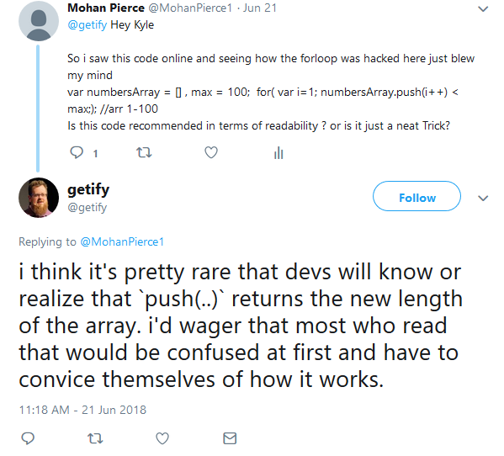
My tweet to Kyle Simpson

Slide 37
WTF JS
Lets see some weird stuff

Slide 38
Thanks for watching

